Slide 1

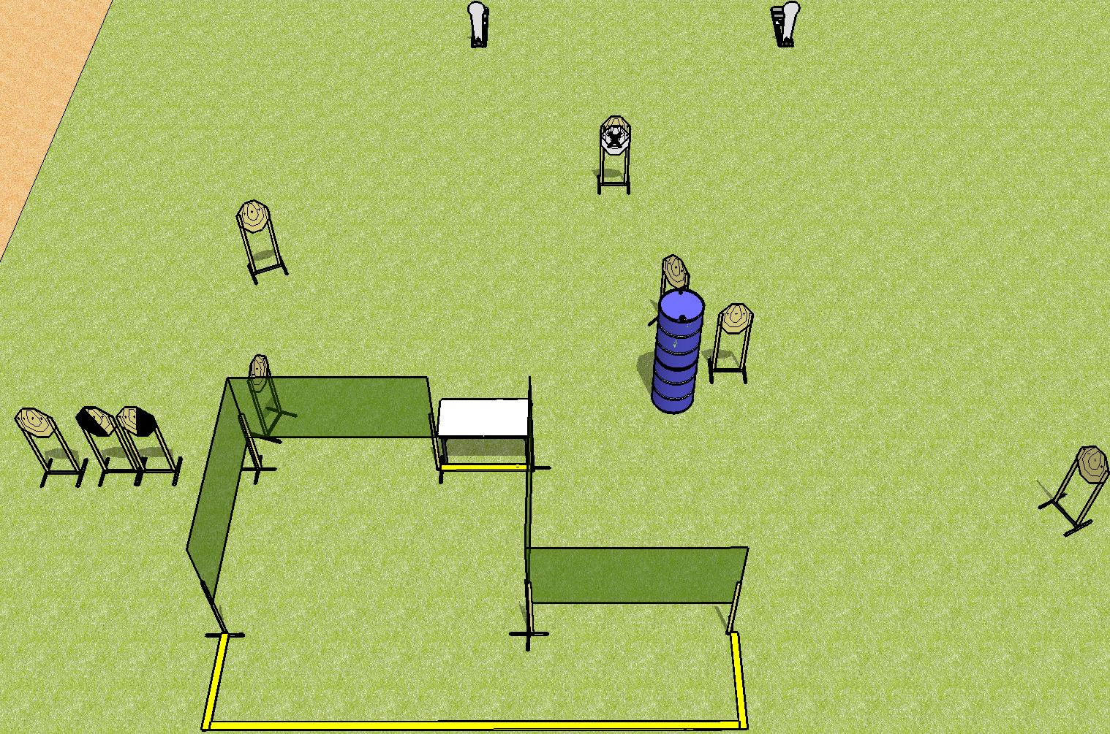
 | Dothan Practical Shooters – USPSA Match Hands On Course Designer : Drew Coleman Bay: B3
Round Count 20 rounds 9 IPSC 2 colt poppers
Equipment List 6 wall feet 8 targets (7 + 1NS) 1 left + 1 right diag

Slide 2
Hands On
Written Stage Briefing
Scoring: Comstock Rounds: 20
Targets: 9 IPSC, 2 steel
Start position: both hands fingers touching walls on either side of table. Firearm is on table, trigger guard on mark, loaded.
Stage Procedure: on the audible start signal, engage targets as they become available from within the shooting area.

